Slide 1
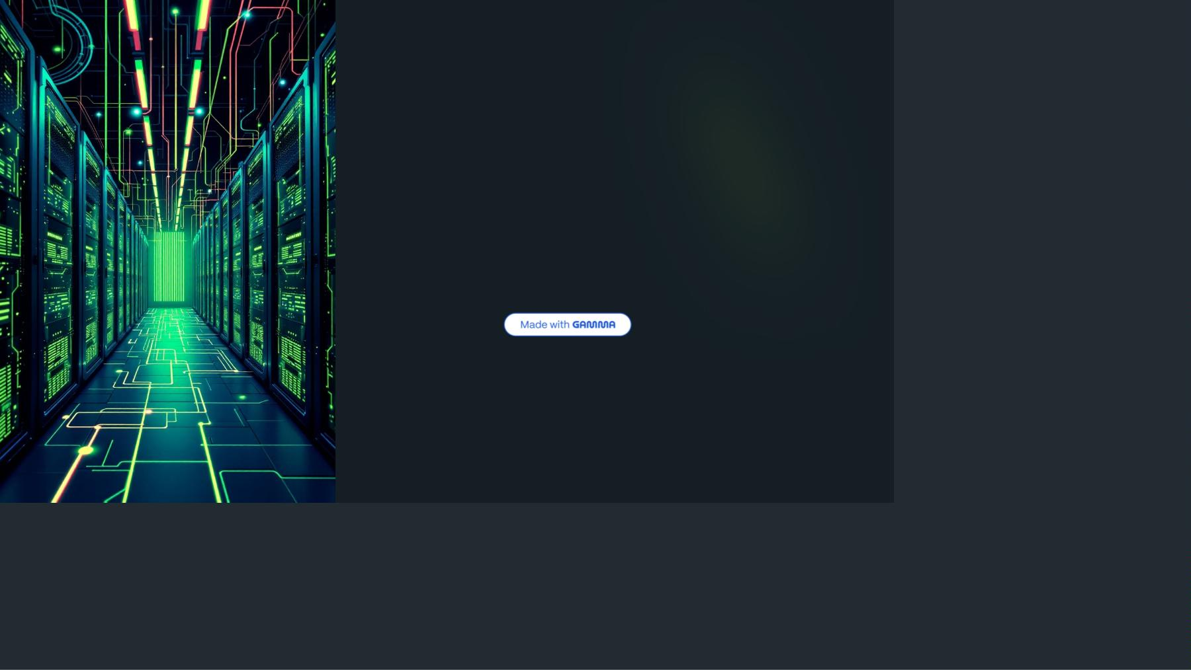
OpenShift
Architecture
Enterprise
Kubernetes
for Modern
Applications

Slide 2

Why OpenShift?
Raw Power
Enterprise
Ready
Complete
Solution
Kubernetes is powerful but lacks
enterprise essentials like logging,
monitoring, and CI/CD.
OpenShift adds the missing pieces
with security-first design and
production-grade features.
Think of Kubernetes as an engine -
OpenShift gives you the full car with
steering and safety.

Slide 3
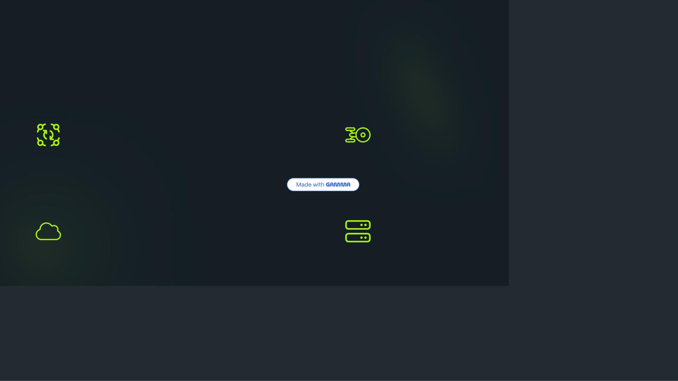
OpenShift Flavors
OKD
Container Platform
Community edition for developers and testing environments.
Enterprise edition with full support and advanced features.
Online
Dedicated
SaaS offering by Red Hat for quick deployment.
Managed clusters for organizations requiring dedicated
infrastructure.

Slide 4
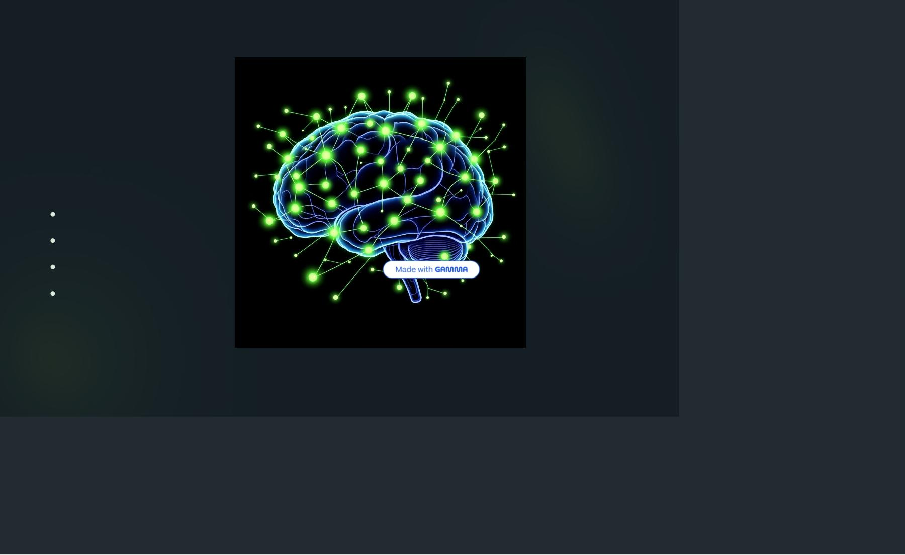
Control Plane Architecture
The Brain of OpenShift
When you say "I want 5 replicas," the Control Plane remembers
that request and ensures it happens.
API Server acts as the front door for all commands
etcd serves as the cluster database
Controller Manager enforces desired state
Scheduler decides optimal pod placement

Slide 5
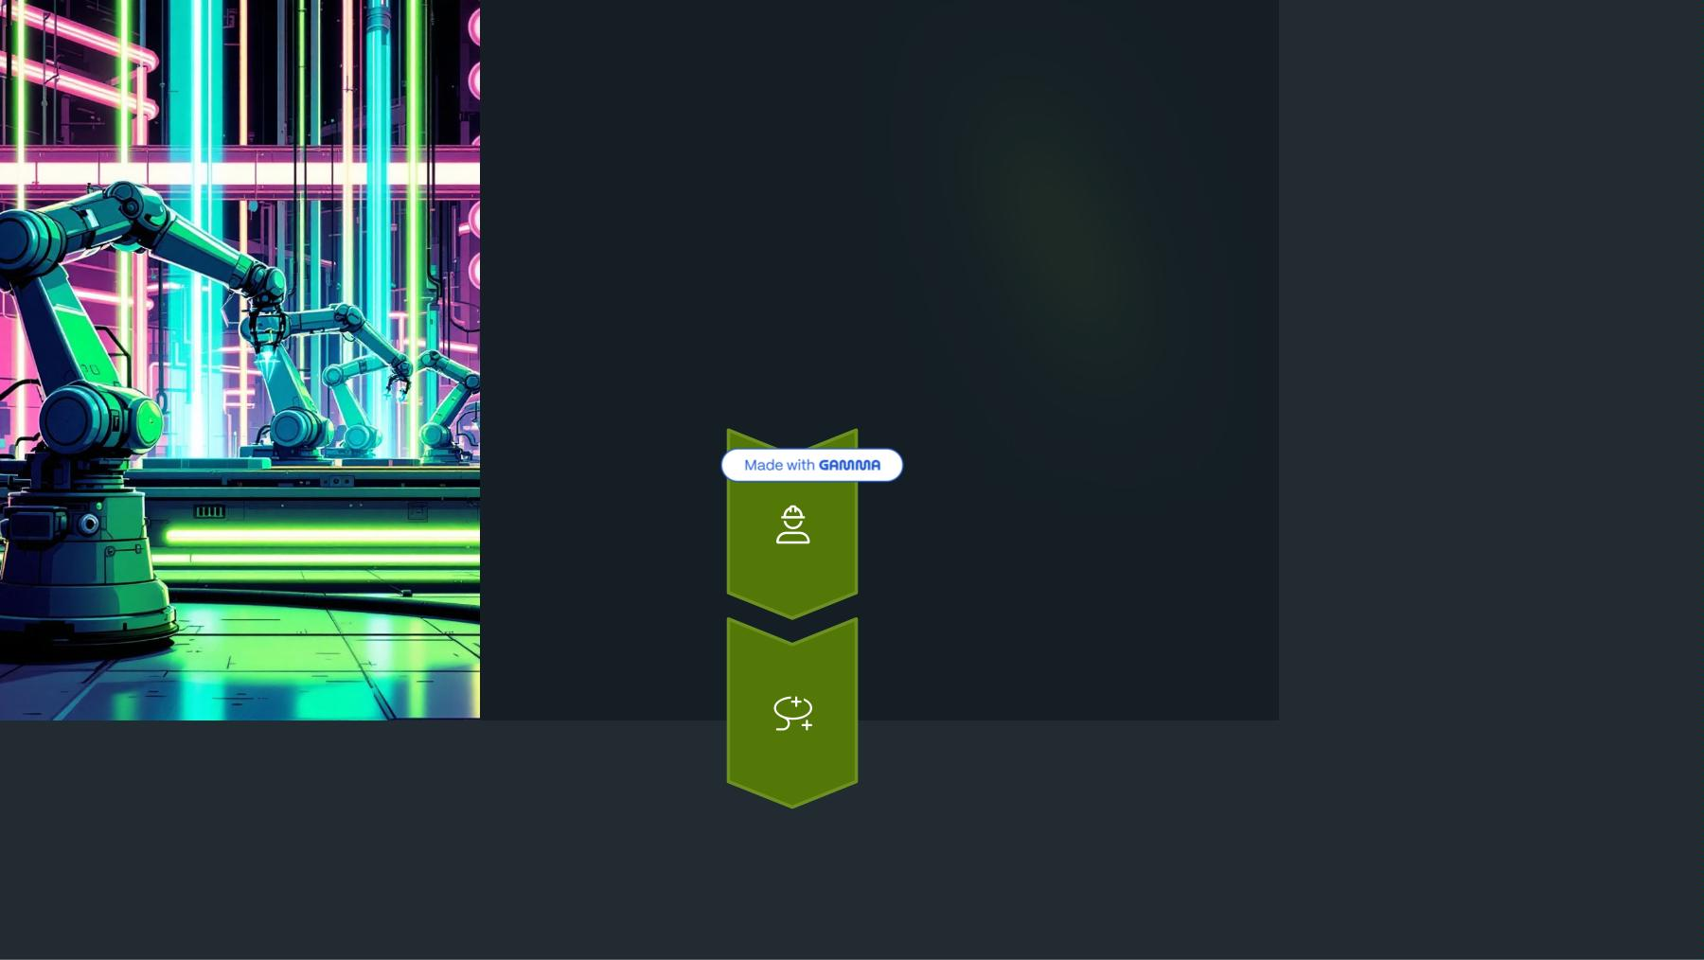
Worker Nodes &
OpenShift
Additions
Worker Nodes
Kubelet (node agent), CRI-O (container runtime), and Kube-proxy
handle the actual workload execution.
OpenShift Operators
Automate application management and node configuration with
Machine Config Operator.

Slide 6
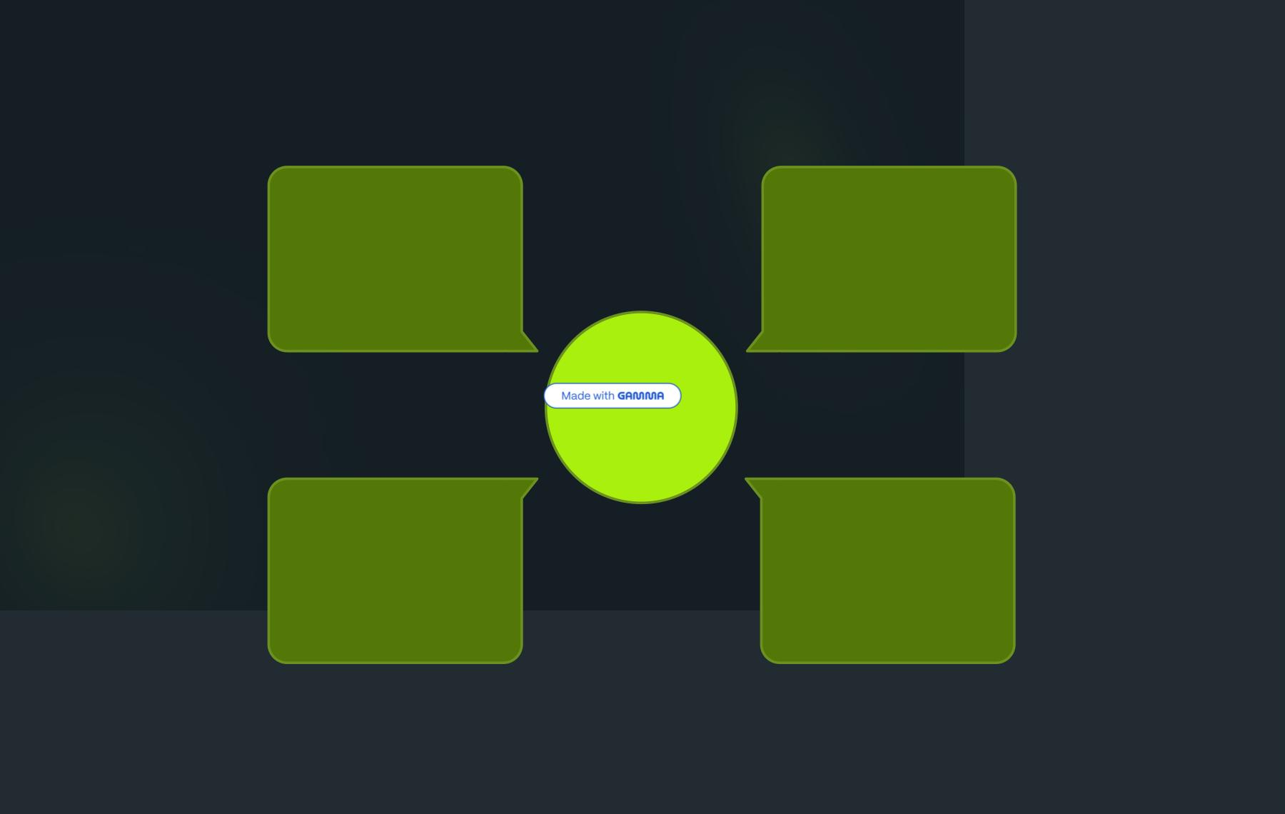
Networking & Routes
External
user
request
Backend
Pod
Receives traffic from
service
Extern
al
HTTP/HTTPS from
client
Acces
s via
OpenS
hift
Route
Service
(ClusterIP)
OpenShift
Route
Stable DNS and load
balancing
Maps URL and
handles TLS
Kubernetes makes internal communication easy, but OpenShift makes external access effortless with Routes. Pods get unique IPs,
Services provide stable DNS, and Routes expose services to the world.

Slide 7
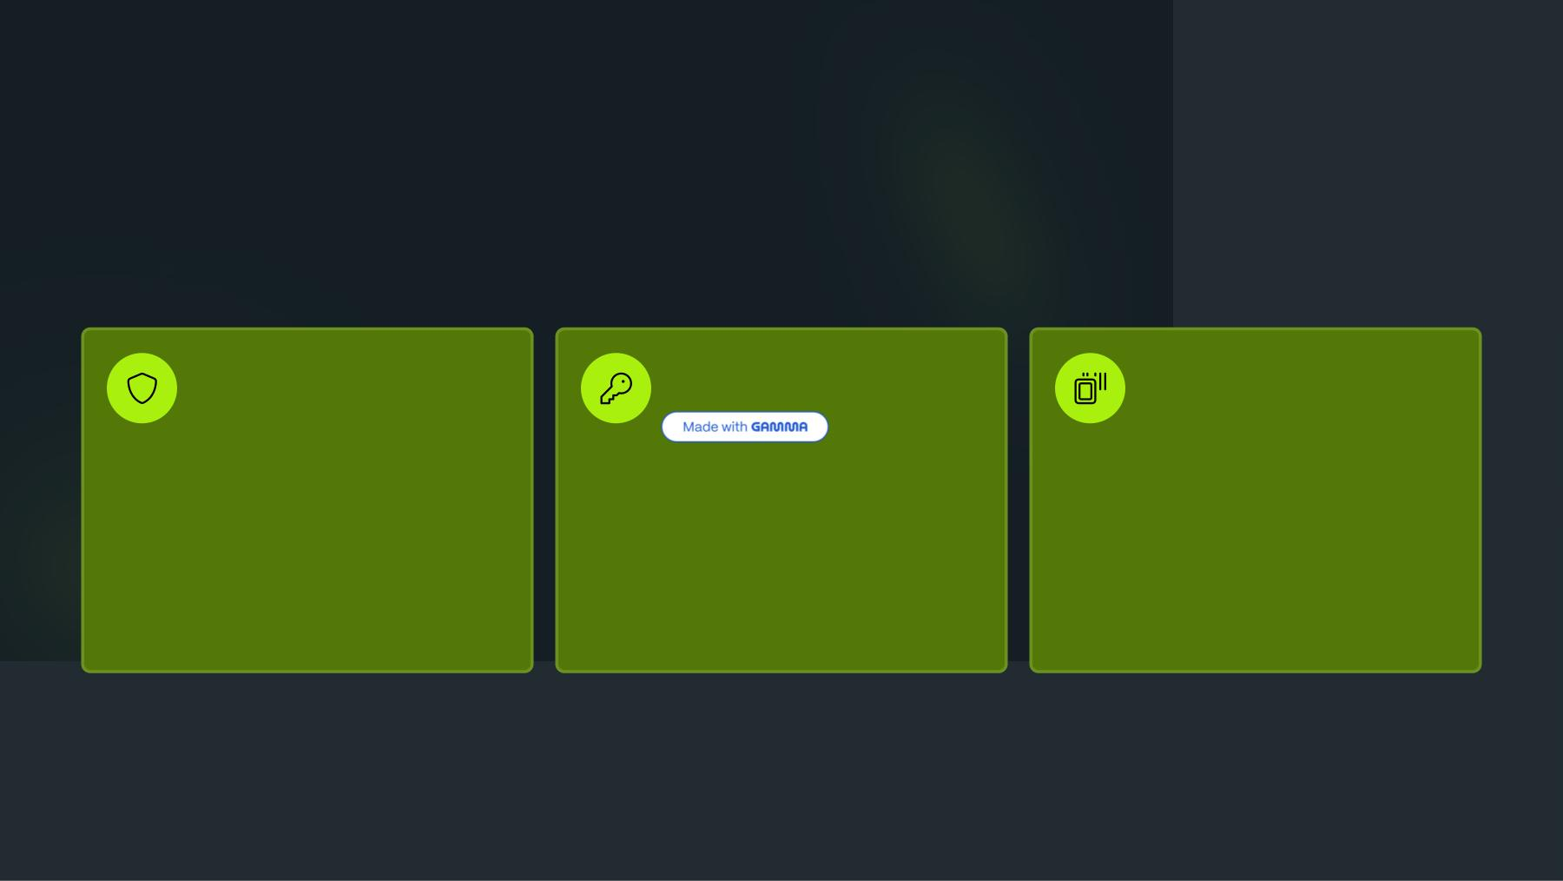
Security-First Design
Security Context
Constraints
RBAC & OAuth
Image Security
Fine-grained user roles with
ImageStreams, vulnerability scanning,
and signed images ensure secure
container deployment.
Stricter than Kubernetes
integration for LDAP, Active Directory,
and GitHub authentication.
PodSecurityPolicies - won't let you run
as root unless explicitly allowed.

Slide 8
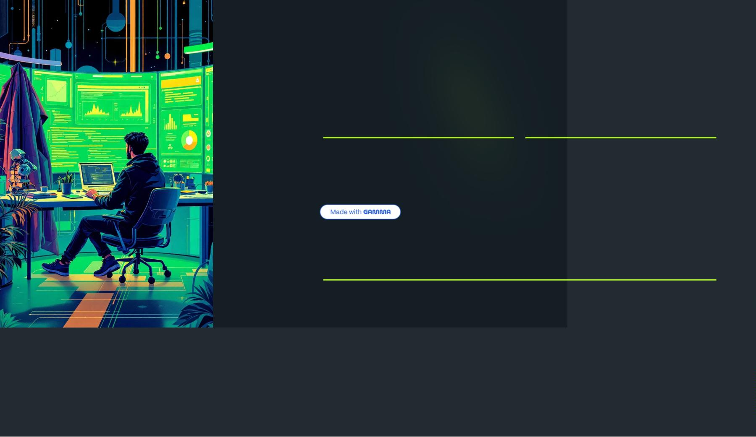
Developer
Experience
01
02
Source-to-
Image (S2I)
BuildConfigs &
DeploymentCon
figs
Build images directly from source
code without writing Dockerfiles.
Automate CI/CD pipelines with
triggers for image changes.
03
Web Console & Operators
Drag-and-drop app deployment with automated database and message
queue management.
A junior developer can deploy applications without touching YAML, thanks to
OpenShift's intuitive developer console.

Slide 9
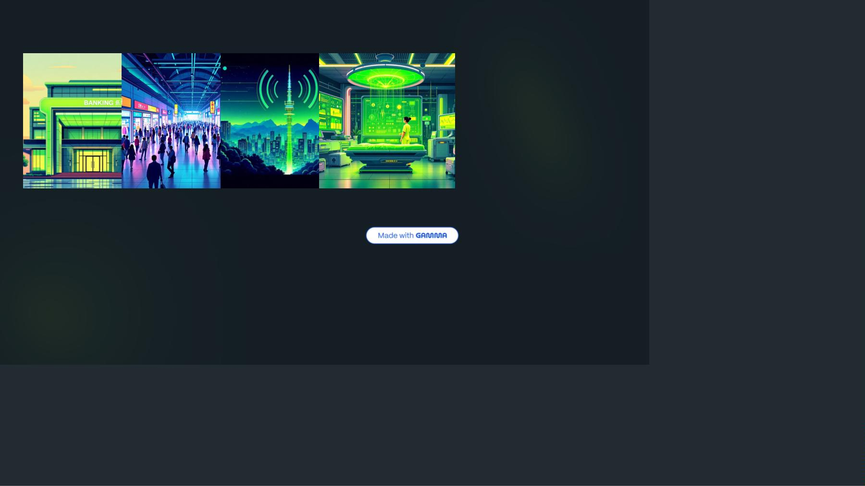
Enterprise Success Stories
Banking
Retail
Telecom
Healthcare
PCI-DSS compliance and
secure workloads for financial
institutions requiring strict
regulatory adherence.
Walmart's Black Friday scaling
demonstrates OpenShift's
5G workloads running on bare
metal infrastructure for ultra-
HIPAA compliance with
comprehensive audit logging
for patient data protection.
ability to handle massive traffic low latency applications.
spikes.
These aren't toy use cases - Fortune 500 companies rely on OpenShift for mission-critical applications.

Slide 10
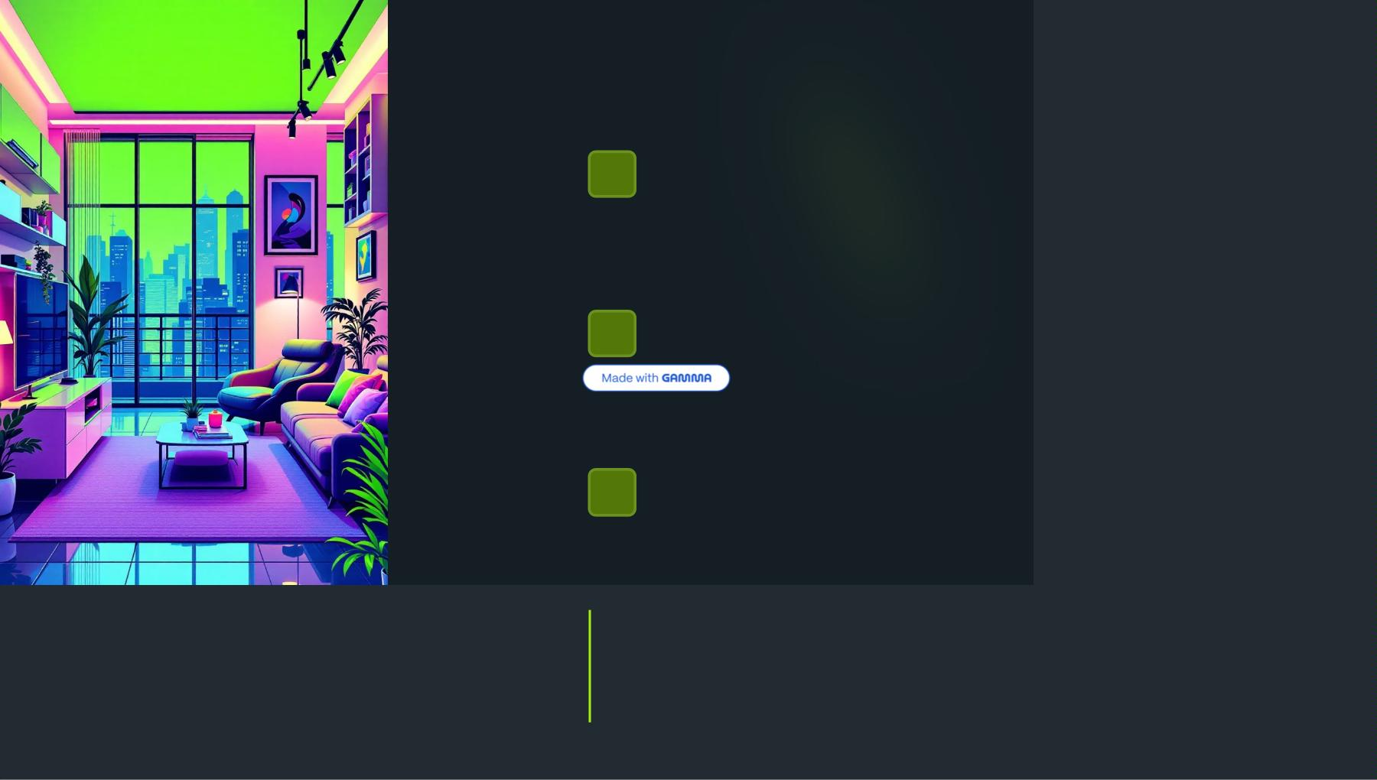
Key Takeaways
Complete Platform
OpenShift = Kubernetes + Enterprise Tools for security, networking,
storage, and monitoring.
Developer Friendly
S2I, Operators, and intuitive consoles make deployment accessible to
all skill levels.
Enterprise Ready
Remember: Kubernetes solves orchestration. OpenShift solves
enterprise adoption.
"Kubernetes is like IKEA furniture 4 you assemble it. OpenShift is like a
ready apartment."

